Slide 1
Pavan Kumar Aryasomayajulu
I work as a Software Architect at Sails Software Solutions

Slide 2
What is Elastic Search?
Elastic Search is a search engine based on Lucene
Near real time search
Some real time issues I faced with Near real time.
Distributed Elasticsearch is a distributed, open source search and analytics engine for all types of data, including textual, numerical, geospatial, structured, and unstructured. Elasticsearch is built on Apache Lucene

Slide 3
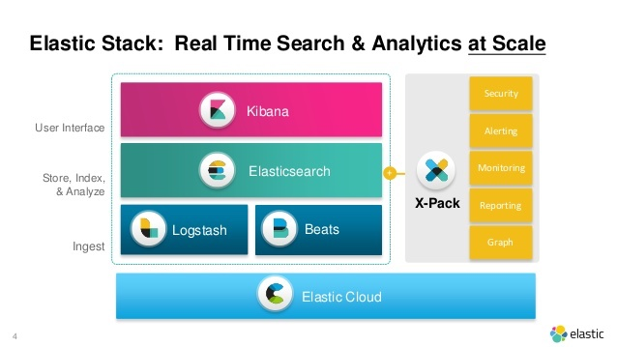
Elk Stack

Slide 4
Installing ElasticSearch Using Docker

Slide 5
Key Terminologies
Document: It is the basic component of ES. It contains data.
Index: Collection of documents
Shard is a Lucene Index which contains documents
Node: A single server which contains multiple shards
Cluster: A collections of Nodes

Slide 6
Replica Shards
Replica Shard is a copy of Primary Shard. The main reason for having a replica shard is to make sure that even if the primary shard /node is down, but still we want our application to run.

Slide 7
We are expecting to store documents related to a Q&A site. I am expecting that the overall load of my site will never exceed 50GB. My machine size is around 1TB and I gave a good amount of RAM. I am not worried even If my site is down for a certain time(even hrs) and I can restore data from somewhere or ok to loose data during downtime or ok even if the data is completely lost because of a hardware failure.

Slide 8
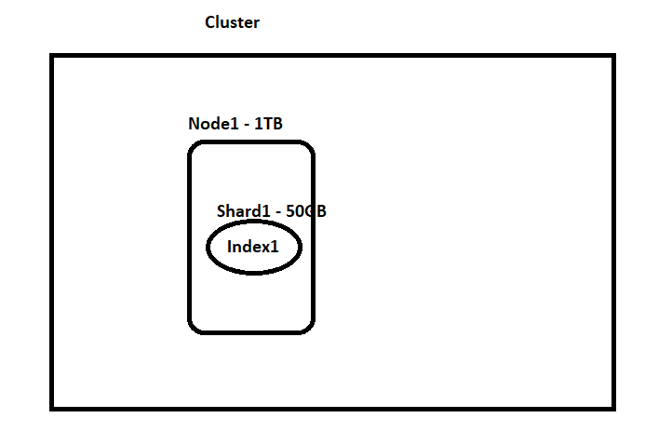

Slide 9
We are expecting to store documents related to a Q&A site. I am expecting that the overall load of my site will never exceed 50GB. My machine size is around 1TB and I gave a good amount of RAM. I am not worried even If my site is down for a certain time(even hrs) and I can restore data from the snapshot and It is ok to lose data during downtime but not complete data

Slide 10
PUT testshard { } Get _cat/indices Lets observe status of index

Slide 11
Now lets try to make index status green?

Slide 12
PUT testshard { "settings": { "number_of_replicas": 0, "number_of_shards": 1 } }

Slide 13
We are expecting to store documents related to a Q&A site. I am expecting that the overall load of my site will never exceed 50GB. My machine size is around 1TB and I gave a good amount of RAM. I want to make sure that we will not have any downtime but I am ok to take the minimal chance of downtime

Slide 14
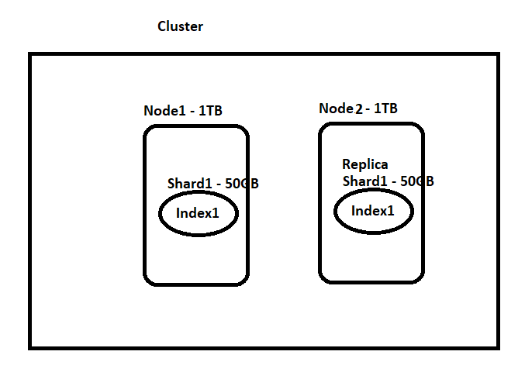

Slide 15
Show demo in Docker Playground

Slide 16
I am expecting that the overall load of my site might be around 1.5TB. My machine size is around 1TB and I gave a good amount of RAM. I want to make sure that we will not have any downtime but I am ok to take the minimal chance of downtime. — Now read below section and decide :)

Slide 17
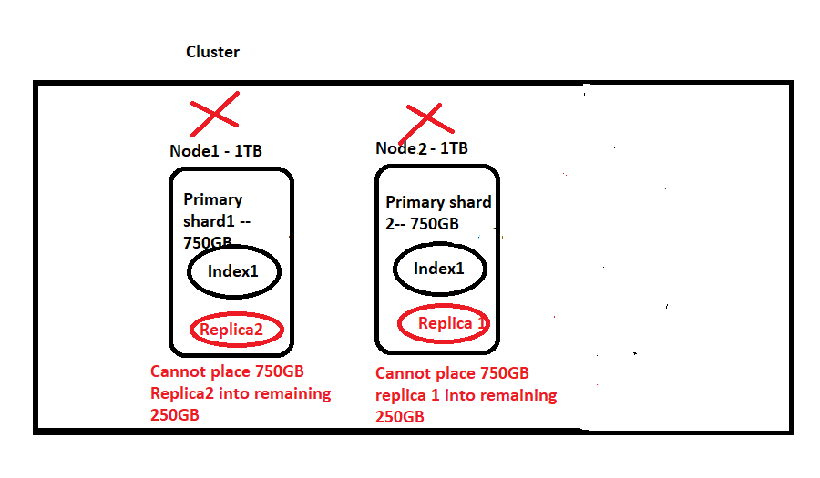

Slide 18
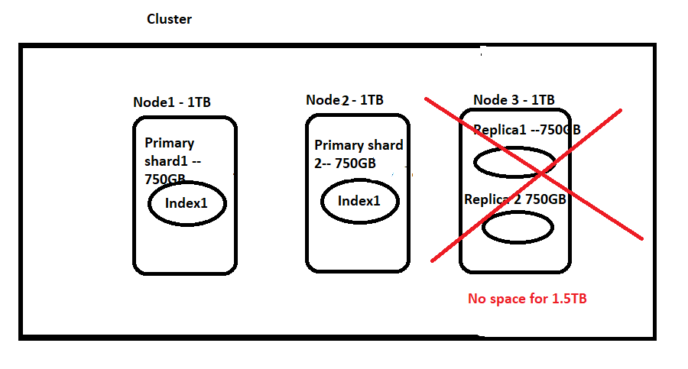

Slide 19
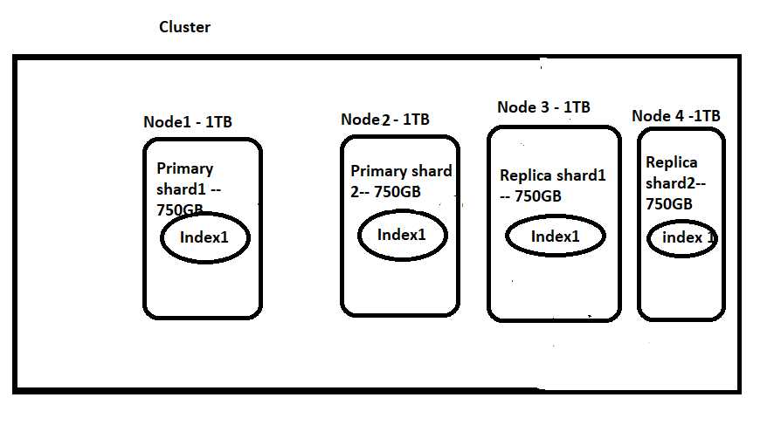

Slide 20
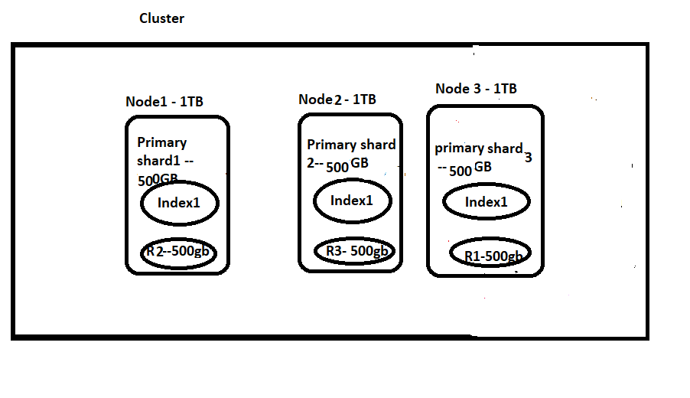

Slide 21
Index some data using Python file

Slide 22
Index Some Data Using Logstash

Slide 23
Inverted Index
Inverted Index is the primary data structure of elastic search. This data structure is the core of the search engine and makes lookup possible

Slide 24
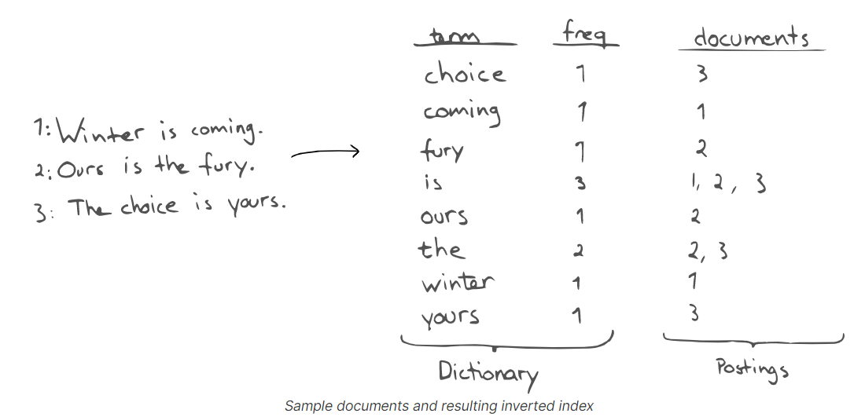

Slide 25
Demo Luke
Post <index>/_refresh

Slide 26
Create a New Index Add Docs
In Luke we can see that newly created index results are not shown.

Slide 27
Flushing an index is the process of making sure that any data that is currently only stored in the transaction log is also permanently stored in the Lucene index. TransLog: Changes to Lucene are only persisted to disk during a Lucene commit, which is a relatively expensive operation and so cannot be performed after every index or delete operation. Changes that happen after one commit and before another will be removed from the index by Lucene in the event of process exit or hardware failure

Slide 28
Post <index>/_flush Now check Luke

Slide 29
Automatic Index Creation
To disable Automatic index creation we can use in elasticsearch.yml action.auto_create_index:false index.mapper.dynamic:false

Slide 30
Insert and Updating Docs

Slide 31
Versioning
Use of “version”
Use of “if_seq_no=4&if_primary_term=1”

Slide 32
Update Doc By POST
POST <index/_doc/<id> { //Need to provide complete Json } If not present , It will add else update. So problem here is it will update entire doc. Just remove few fields and update, we can see some data is lost

Slide 33
Update API
In contrast to previous example Put <index>/_update/<id> { “doc”: { //fields to update } }

Slide 34
Update By script
Post school/_update/10 { "script": { "source": "ctx._source.rating = Float.parseFloat(ctx._source.rating)+1 " } }

Slide 35
Update by query
Post school/_update_by_query { "script": { "source": "ctx._source.rating = Float.parseFloat(ctx._source.rating)+1 " }, "query": { "match": { "_id": 11 } }}

Slide 36
Delete Doc
Delete by query
Delete by id delete <index>/_doc/<id>

Slide 37
Retrieve Doc by Id
GET <index>/_doc/<id>

Slide 38
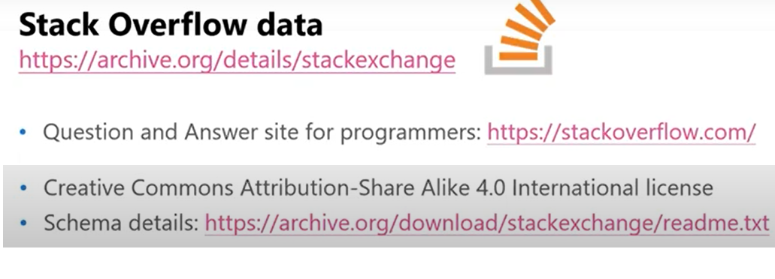

Slide 39
https://archive.org/download/stackexchange https://www.brentozar.com/archive/2015/10/how-to-download-the-stack-overflow-database-via-bittorrent/

Slide 40
https://meta.stackexchange.com/questions/9134/jon-skeet-facts

Slide 41
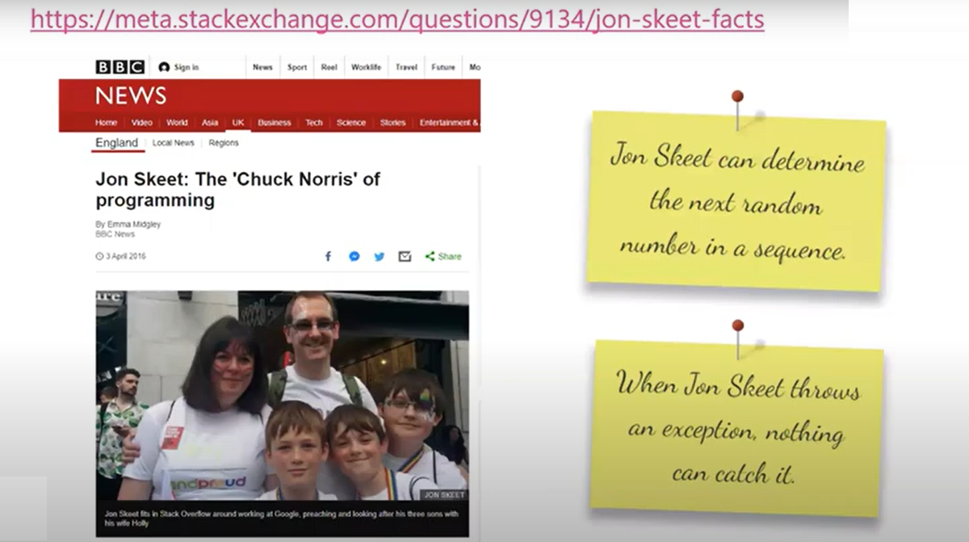

Slide 42
http://askjonskeet.com/

Slide 43
Match Queries

Slide 44
Questions answered by JonSkeet Get stackoverflow/_search{ "query": { "match": { "owneruserid": "22656" } }}

Slide 45
Match Phrase
The match_phrase query analyzes the text and creates a phrase query out of the analyzed text. GET /stackoverflow/_search
{
"query": {
"match_phrase": {
"body": "This should do"
}
}
}

Slide 46
Get All questions/ans by Jon Skeet and has Tags
Get stackoverflow/_search{ "query": { "bool": { "must": [ { "match": { "owneruserid": "22656" } }, { "exists": { "field": "tags" } } ] } }} select * from Posts where owneruserid=22656 and Tags is not null

Slide 47
Bool Queries
A query that matches documents matching boolean combinations of other queries. The bool query maps to Lucene BooleanQuery. It is built using one or more boolean clauses, each clause with a typed occurrence. The occurrence types are: Must, Must_Not,Filter,Should

Slide 48
Range queries
To find all posts between dates Get stackoverflow/_search{ "query": { "range": { "creationdate": { "gte": "2008-01-01T14:39:30.143Z", "lte": "2020-01-01T14:39:30.143Z" } } }}

Slide 49
Selecting Specific fields
Get stackoverflow/_search{ "query": { "match": { "tags": "python" } }, "_source":["commentcount"]}

Slide 50
Mapping
PUT /my-index { "mappings": { "properties": { "age": { "type": "integer" }, "email": { "type": "keyword" }, "name": { "type": "text" } } } }

Slide 51
Add New Mapping
PUT /my-index/_mapping { "properties": { "employee-id": { "type": "keyword", "index": false } } }

Slide 52
Analyzers
POST _analyze { "analyzer": "whitespace", "text": "The quick brown fox." } POST _analyze { "tokenizer": "standard", "filter": [ "lowercase", "asciifolding" ], "text": "Is this déja vu?" }

Slide 53
Analyze API
Get /_analyze{ "text":"<python><python-2.6><python-datamodel>"} GET /_analyze{ "tokenizer" : "keyword", "filter" : ["lowercase"], "char_filter" : ["html_strip"], "text" : "aa <python><python-2.6><python-datamodel>"}

